Slide 1
To look forward to
Part 5: Rev 20:1-6
Preached by Dr. Jim Harmeling at Crossroads International Church Singapore • CICFamily.com Uploaded by Dr. Rick Griffith • Singapore Bible College Files in many languages for free download at BibleStudyDownloads.org

Slide 2
To look forward to
Fixing our sight on God’s revelation of the future

Slide 3
Christ
Returns
with Church
Church
removed

Slide 4
Rejoice! Evil is Defeated (19:1-5)
Rejoice! The King Reigns and His Bride is Ready (19:6-10)
Behold! He comes (19:11-21)

Slide 5
Thy Kingdom Come (vs. 1-6)

Slide 6
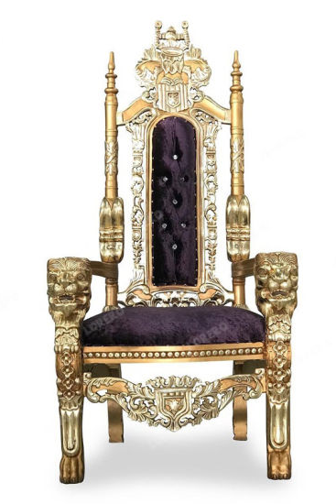
2 Samuel 7:16
“And your house and your kingdom shall be made sure forever before me. You throne shall be established forever.”
Psalm 89:3-4
³ You have said, “I have made a covenant with my chosen one; I have sworn to David my servant: ⁴ ‘I will establish your offspring forever, and build your throne for all generations.’”

Slide 7
Luke 1:32-33
“He will be great and will be called the Son of the Most High. And the Lord God will give to him the throne of his father David, ³³ and he will reign over the house of Jacob forever, and of his kingdom there will be no end.”
Matthew 21:1-13

Slide 8
The Kingdom of God
1st coming
Jesus announces himself as king
recruiting and redeeming subjects for his kingdom
2nd coming
Jesus comes as king
ruling over subjects of his kingdom
1000 years

Slide 9
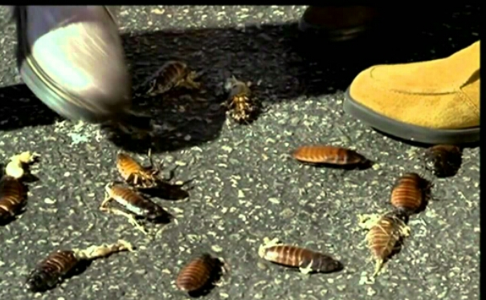
Christ
Returns
with Church
Human
opponents
destroyed

Slide 10
Christ
Returns
with Church
Human
opponents
destroyed
Satan
bound

Slide 11
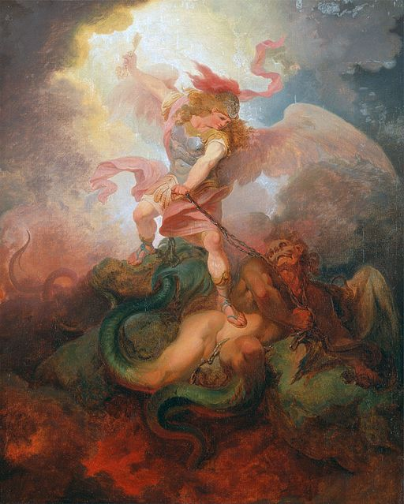
The Abyss (vs. 1-3)
Hold for demonic spirits
Luke 8:30-31
³⁰ Jesus then asked him, “What is your name?” And he said, “Legion,” for many demons had entered him. ³¹ And they begged him not to command them to depart into the abyss.

Slide 12
The Abyss (vs. 1-6)
Hold for demonic spirits
Satan bound 1000 years

Slide 13
The Reign of Christ (vs. 4-6)
We rule with Christ
Matthew 19:28
Jesus said to them, “Truly, I say to you, in the new world, when the Son of Man will sit on his glorious throne, you who have followed me will also sit on twelve thrones, judging the twelve tribes of Israel.”
1000 years

Slide 14
The Reign of Christ (vs. 4-6)
We rule with Christ
1 Corinthians 6:1-3
¹ When one of you has a grievance against another, does he dare go to law before the unrighteous instead of the saints? ² Or do you not know that the saints will judge the world? And if the world is to be judged by you, are you incompetent to try trivial cases? ³ Do you not know that we are to judge angels? How much more, then, matters pertaining to this life!
1000 years

Slide 15
Christ
Returns
with Church
Human
opponents
destroyed
Satan
bound

Slide 16
Joy to the world! the Lord is come; Let earth receive her King; Let every heart prepare him room, And heaven and nature sing, And heaven and nature sing, And heaven, and heaven,
and nature sing.
Joy to the world! the Saviour reigns; Let men their songs employ; While fields and floods, rocks, hills, and plains Repeat the sounding joy, Repeat the sounding joy, Repeat, repeat the sounding joy.

Slide 17
He rules the world with truth and grace, And makes the nations prove The glories of His righteousness, And wonders of His love, And wonders of His love, And wonders, wonders, of His love.

Slide 18
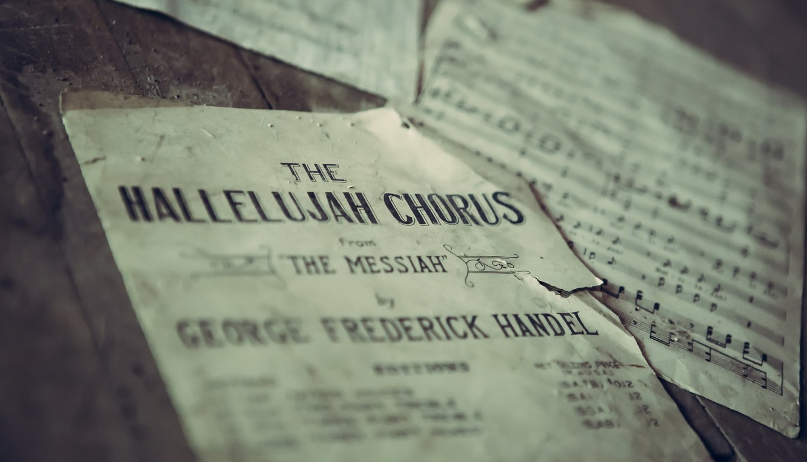

Slide 19
Black

Slide 20
Topical Preaching link at BibleStudyDownloads.org
Get this presentation for free!
Notes:
The Bible…Basically (bb)

